Slide 1
How can we reduce energy usage & cost at Earl Wooster High School by 10%?
Adriana Cerda & Ivette Murillo & Zona Hairgrove

Slide 2
Mission Statement
Reduce energy usage and cost by 10%
Motion sensor lights
Light bulbs that consume less electricity

Slide 3
Statement of Need
We are trying to address the importance of reducing energy consumption from the school
This will save the school time and money
This will reduce the amount of pollution in the earth
The pollution mentioned above is the gas inside the fluorescent lights that when broken, releases into the air

Slide 4
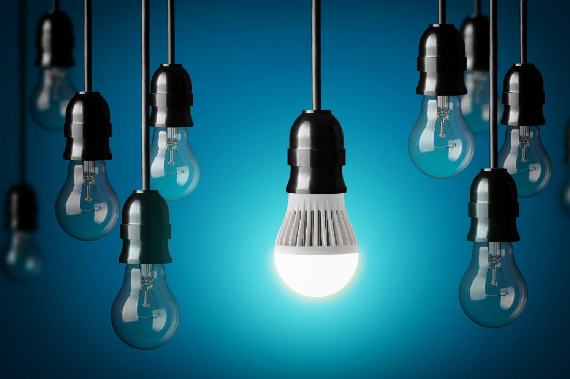
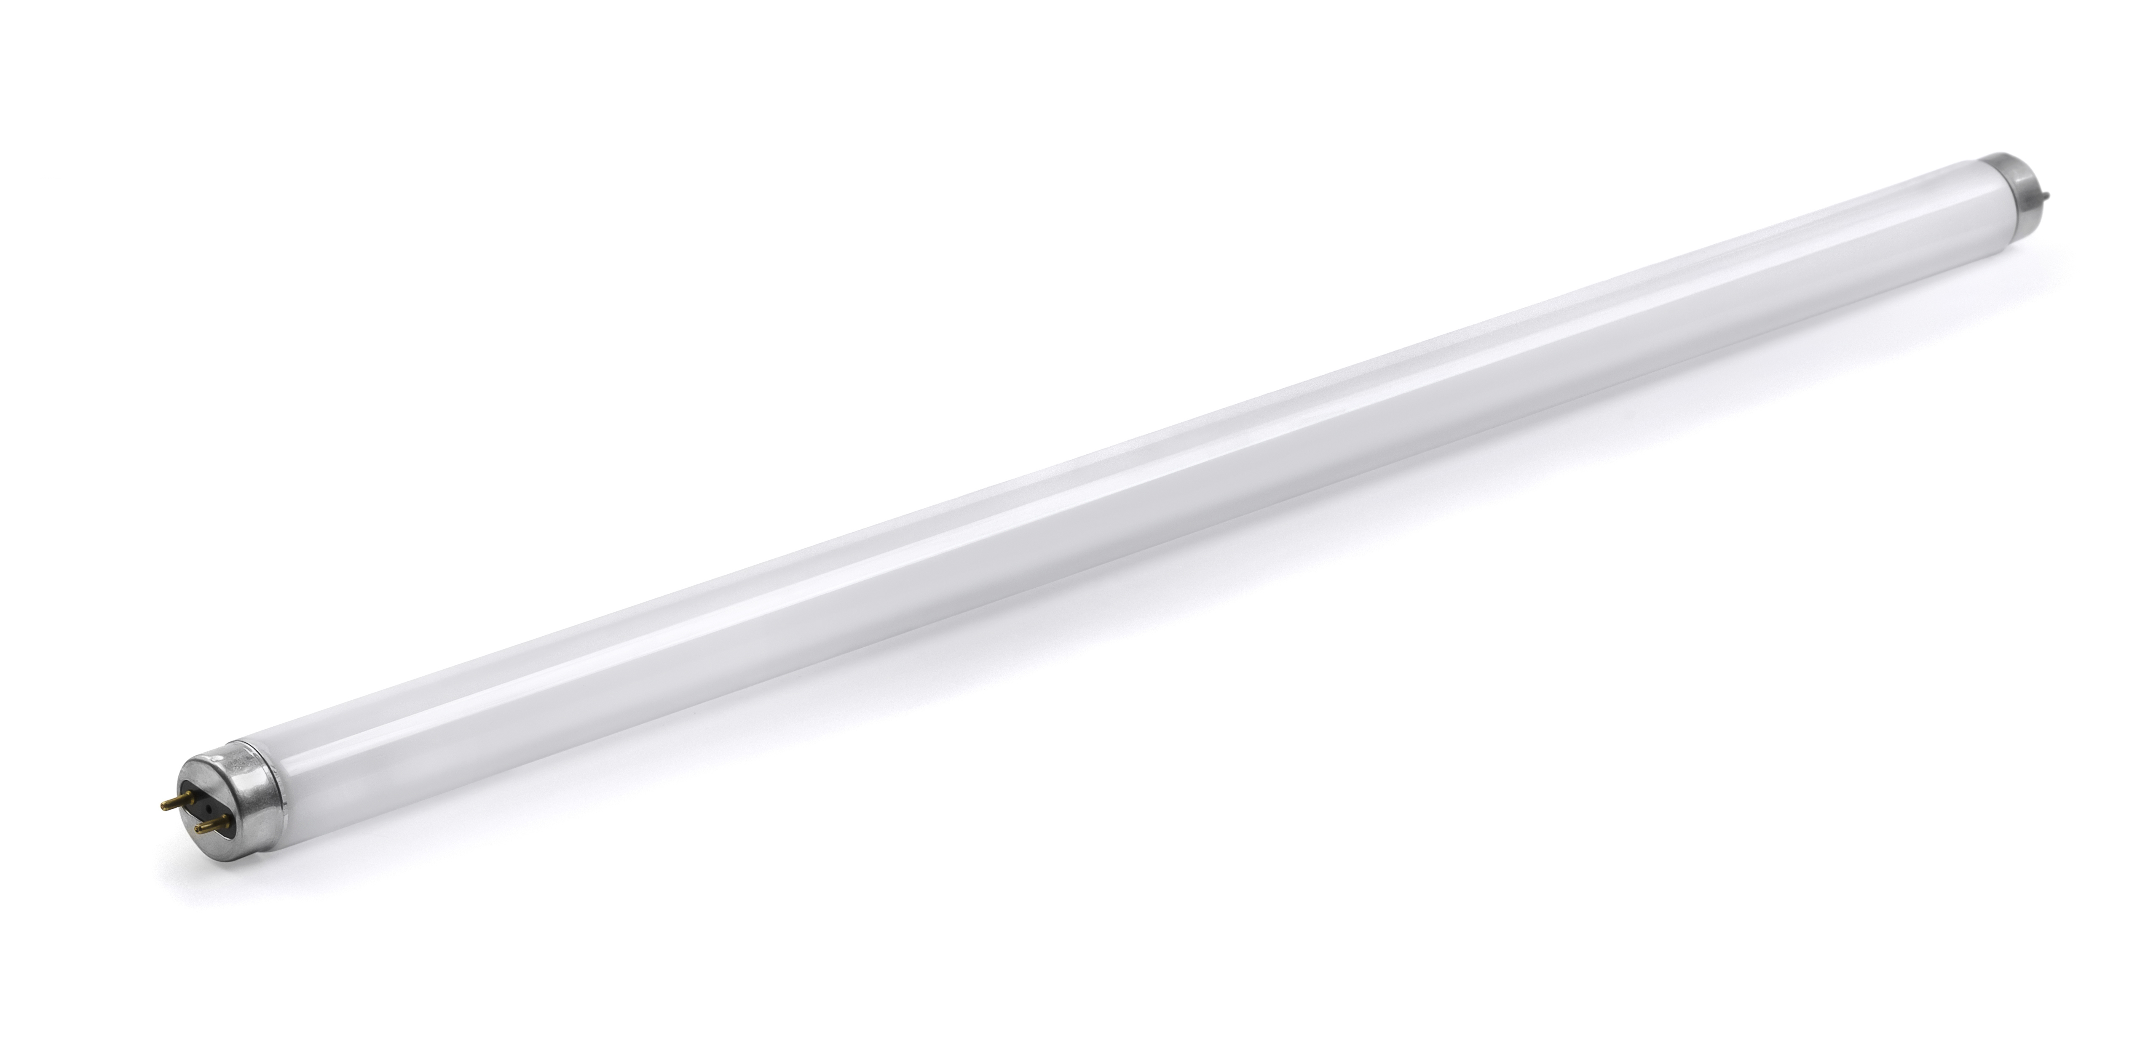
Goals & Objectives
Change the lights to LED lights
5,700 fluorescent 32 watt light bulbs in the school
Each costing $83.97
$478,629 total to light the school
Change to LED lights
60 watt for $28.53 each
$162,621 total to light the school

Slide 5
Project Activities
Classrooms
When it's nice outside have class outside meanwhile the lights will be off
When lights are needed they will turn on automatically and off when not in need
Afterschool hours in the hallways when no one is here they will be turned off
Computer rooms and office computers need to be off at all times when not needed

Slide 6
Impact Analysis
Pros
Cons
All the money saved can go towards programs
Getting people to contribute

