Slide 1
MUTUAL FUNDS
Created By: Adriana Cerda

Slide 2
WHAT IT IS
An investment vehicle
A pool of funds collected from investors
Operated by money managers

Slide 3
PROCESS
Each shareholder participates proportionally in the gain or loss of the fund
Can typically be purchased or redeemed as needed at the fund's current price

Slide 4
BENIFITS
Access to diversified portfolios, bonds, and other securities which would be quite difficult (if not impossible) to create with a small amount of money
By purchasing mutual funds, you are provided with the immediate benefit of instant diversification and attempt to balance the investment of each portfolio without the large amounts of cash needed to create individual portfolios

Slide 5
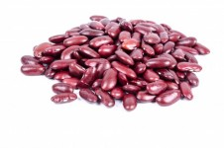
sources
http://www.investopedia.com/terms/m/mutualfund.asp

